Slide 1


Prayer Application
By Noah Funderburgh
Screen Cast https://www.loom.com/share/0bbece00cd1f47e1a71aa0dcbf9780b5

Slide 2
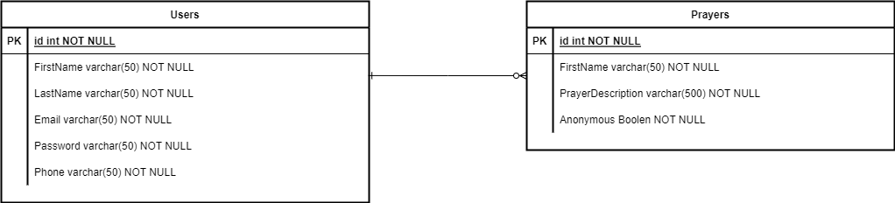
Design updates
No Design update were changed from last week design report
I was able to use the same database design I planned last week
TO DO:
Create API Entry Points for Users

Slide 3
Rest API's
Rest API - https://www.loom.com/share/8284d3d588a243ddb85a30e05d72d7bd
Get Prayers - http://localhost:5000/prayers
Returns list of all prayers within the database
Create Prayers - http://localhost:5000/prayers
Creates a prayer and adds it into the database
Update Prayers - http://localhost:5000/prayers
Updates a prayer and changes it in the database
Delete Prayers - http://localhost:5000/prayers/4
Deletes a prayer from the database

Slide 4
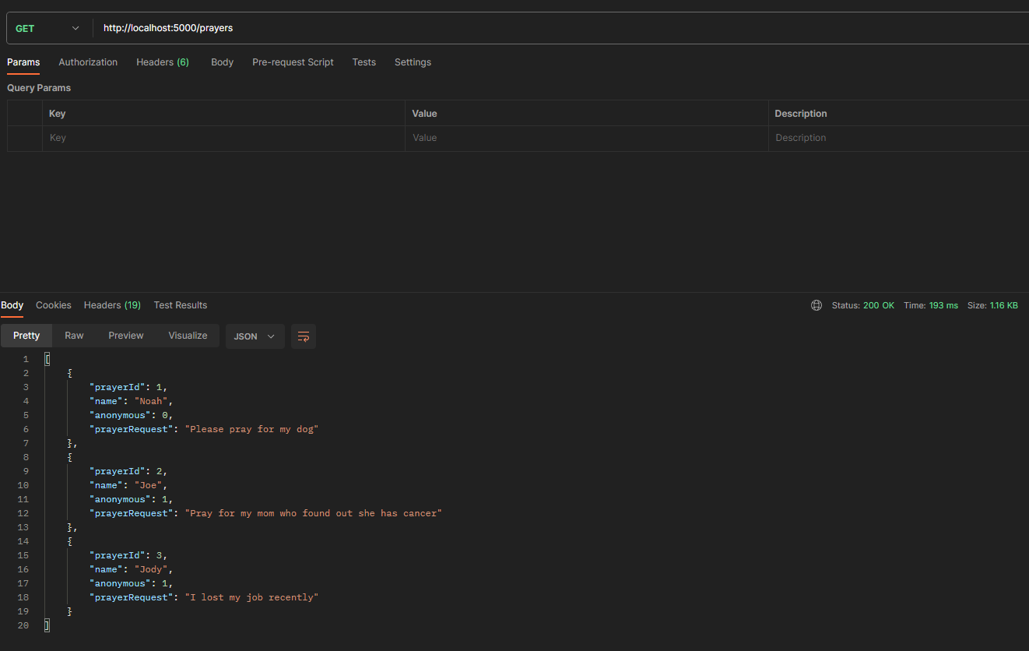
Get Prayers

Slide 5
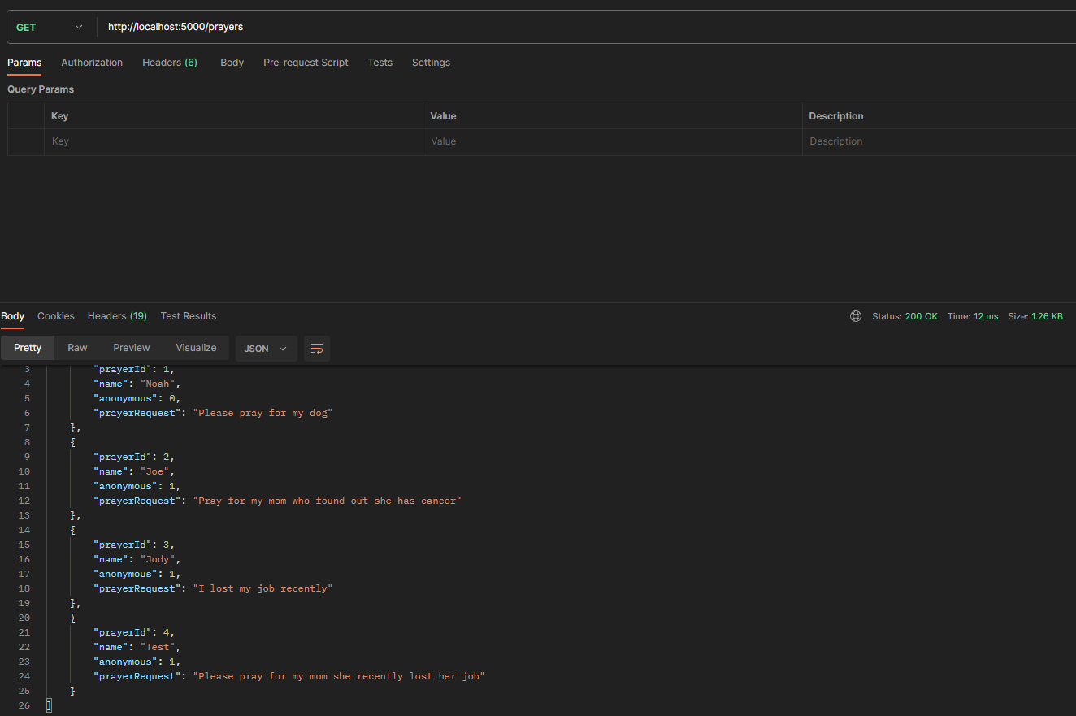
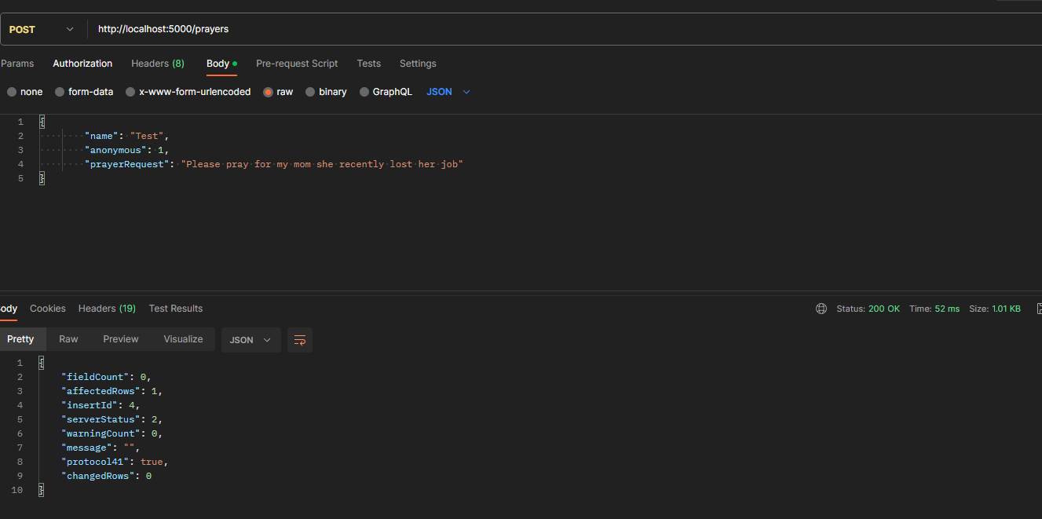
Create Prayers

Slide 6
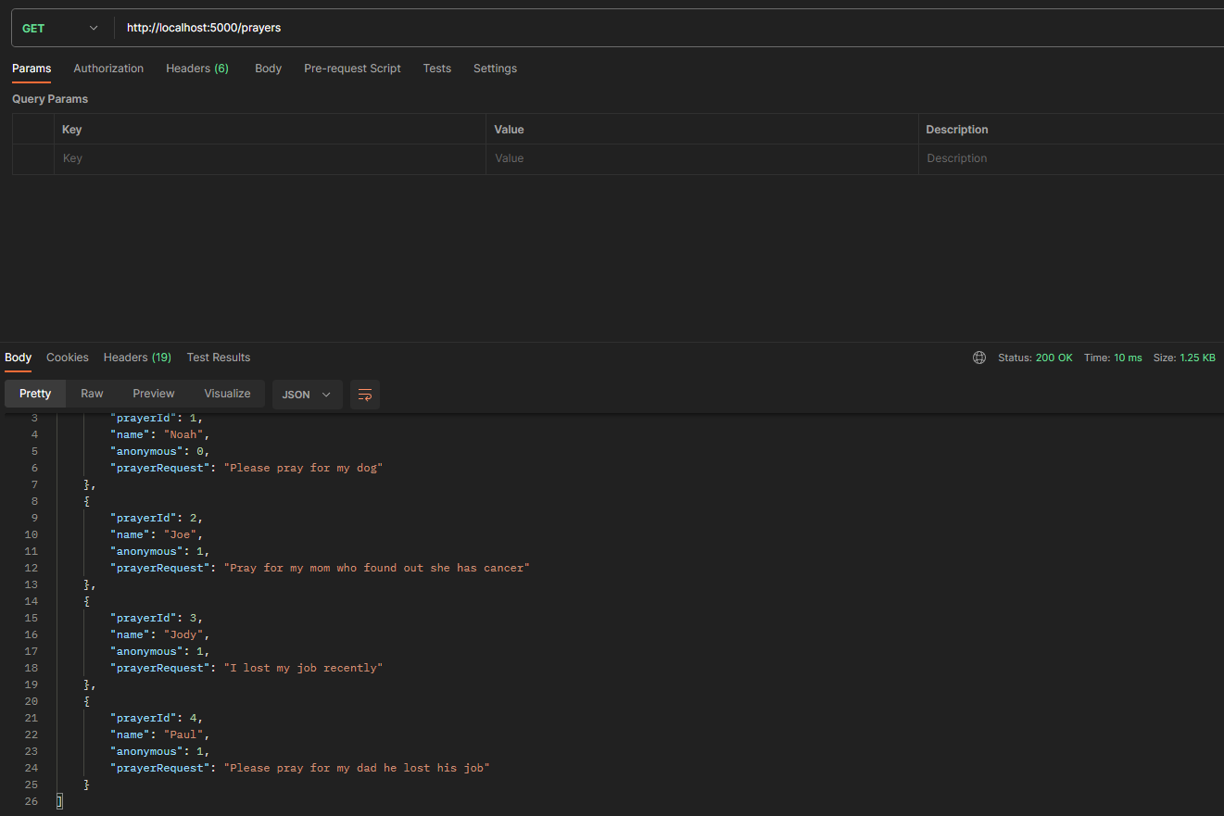
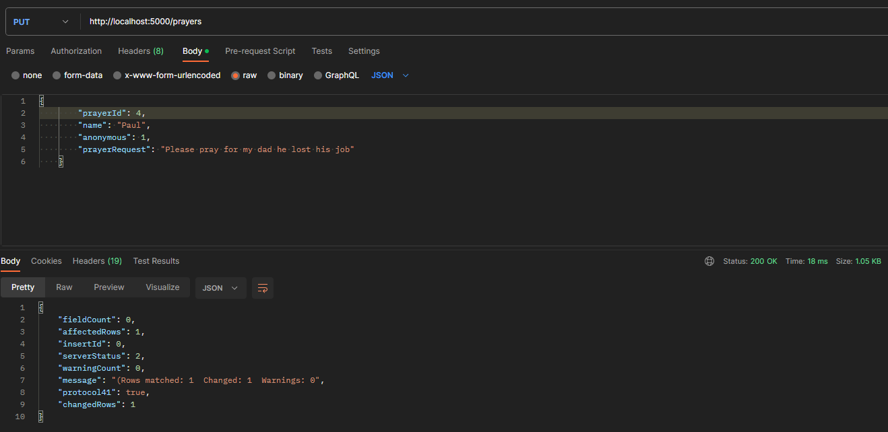
Update Prayers

Slide 7
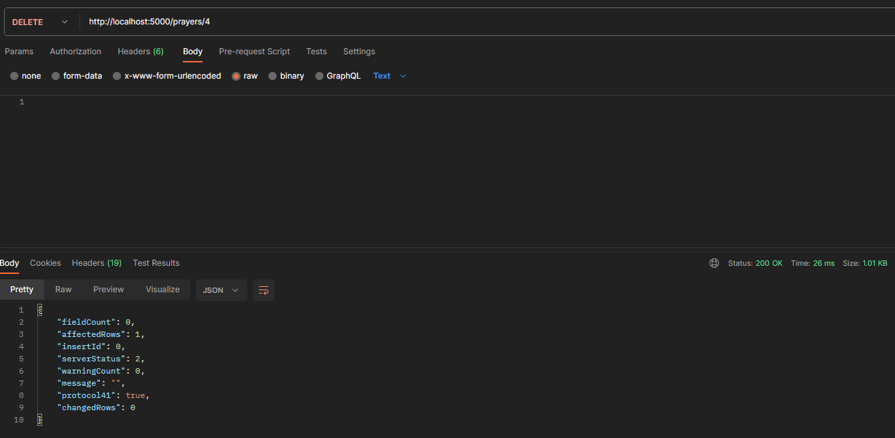
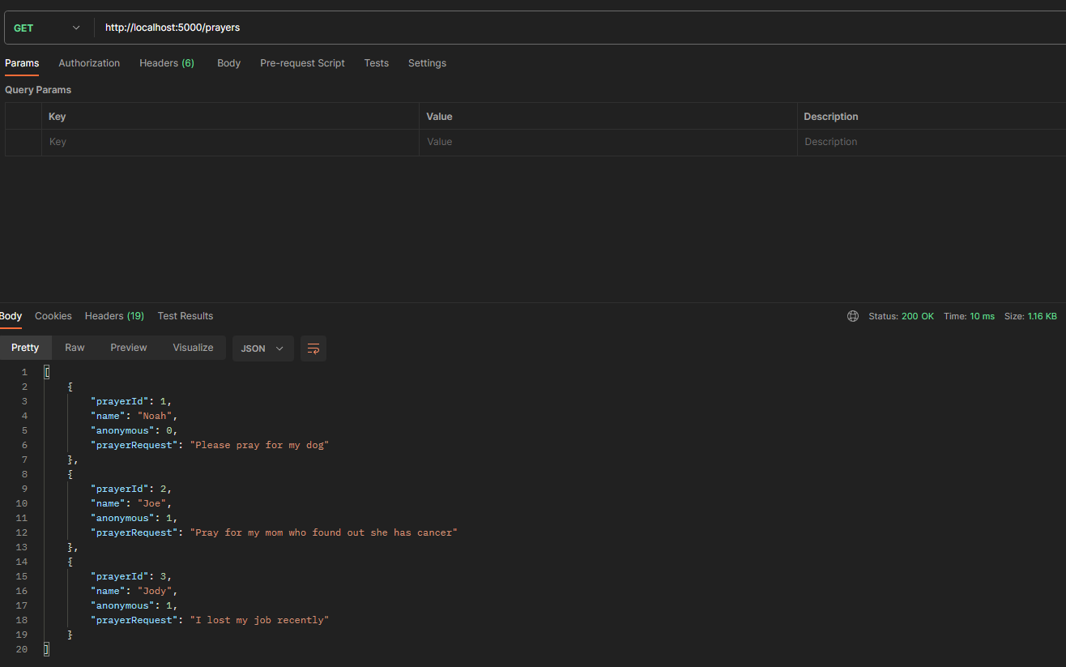
Delete Prayers

Slide 8
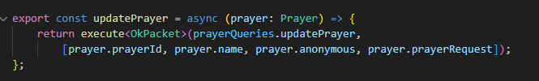

Challenges
Update prayer API wasn't working due to incorrect parameter order
Original
Fixed
Had trouble connecting to MySQL database
I had to create a new user with all privileges

Slide 9
Pending bugs or issues
There are no Pending bugs or issues
All API Entry points work as intended

Slide 10
Lessons learned for future web projects
I learned that privileges are important to access to the database
Giving users certain permissions allow them to perform various operations on the database
From a security persecptive you want users to have as little permissions as possible

Slide 11
Links
Git Repo - https://github.com/nfunderburgh/CST-391Milestone.git
Zipped Code - CST-391Milestone.zip
API Entry Points - https://www.loom.com/share/8284d3d588a243ddb85a30e05d72d7bd
API's Code - https://www.loom.com/share/40923f9cbc86485eae8c33b17cc05f63

